Slide 1
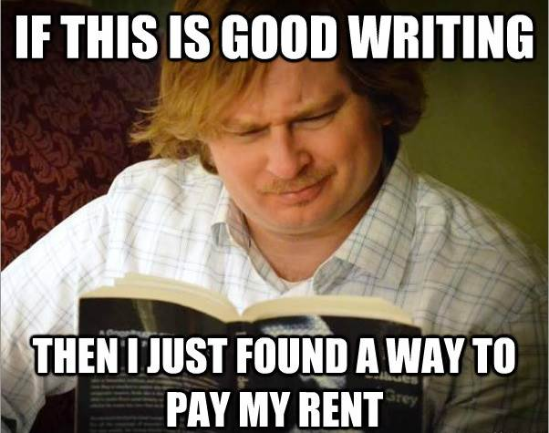
Rules for Publishing

Slide 2
Events on the horizon
Journal Due Dates
1/17: 15 pp
1/31: 15 pp
2/14: 15 pp
3/1: 15 pp
3/15: 15 pp
3/30 : 15 pp
4/20 : 15 pp
5/4 : 15 pp
5/18: 15 pp due, 15 for extra credit
You can exempt one journal date
Publishing Semester 2
1/25: Rough Draft for True Pub Piece
1/29-2/2: Writing Workshop; 2 groups
2/6: Incriminating Ink. piece(s) due
2/6: True Publishing Piece, send it out
3/9: Rough Draft Due
3/15: Final Draft due
5/4: Rough Draft of last pub piece due
5/14: Final Piece Due

Slide 3
Rule One: Write
Every book says it. The first rule of write club is to write.

Slide 4
Step 2: Choose what to publish
No parts of things!
Narrow it down to a few pieces, more if poetry.
Ask someone familiar with your writing to find the best piece. We don’t always know what we do best!

Slide 5
Step 3: Choosing a literary magazine
Make an organized list of what you have sent to whom.
Don’t be too scared to send your pieces to big lit mags.
Don’t be too proud to send it to a legitimate, but small press.
Getting published the first time makes writing letters to other publishers easier.

Slide 6
Step 3 also: Contests are fun, they often give prompts or structures that will challenge/inspire you.
https://thewritelife.com/27-free-writing-contests/
https://theprose.com/challenges/popular
http://www.writersofthefuture.com/enter-writer-contest/
https://algren.submittable.com/submit
http://www.pw.org/writing_contests/short_story_award_new_writers
http://www.pw.org/grants?page=11&sort=asc&order=Deadline&apage=%2A

Slide 7
Step 3, finally: Self-publishing is a possibility. I know someone who has made about $10,000 over the last couple of years publishing her pieces herself.

Slide 8
Step 4: Read the lit mag/previous contest winners to which you are submitting!
Writing the cover letter for your piece(s) is easier if you have read the magazine, you can reference pieces you liked as well as pieces that fit your style of writing. Plus, it is a form of sucking up that is acceptable.
Reading also gives you the added benefit of learning something about what is publishable.

Slide 9
Step 5: Edit Your Piece!
You have never edited your piece like you will need to do for publishing professionally.
Use the resources around you, your writing group and others in the class.

Slide 10
Step 6: Send it off!
Cover letter and formatting will be done later in the semester.
Don’t be afraid to send your pieces! I know who is afraid in here. I’m looking at you, Everybody.
I will be speaking more on each of these rules as we go forth to publish. Everyone will need to send a piece to a lit mag or contest, or publish a piece on their own by the end of January

Slide 11
Picking out Pieces
Try to think about the best 3-5 things you have ever written.
In your journal, take up three pages, one for each of the pieces.
Under the title of each piece, summarize it from memory, don’t look at it yet even if you can.

Slide 12
“Giving” by Anne Lamott
Let’s turn to p. 202 of Anne Lamott’s book and read.
Discuss:
What can we learn from her chapter?

Slide 13
“Giving”
What do each of the three pieces you chose give to the world? (the answer is not “nothing,” so shut that answer the hell up)
Write this in the space after your summary

Slide 14
Meet your editors
Editor-in-Chief: Dina Biroukova
Copy Editor: Kailey Boyles
Managing Editor: Peyton Humphreys
Communications Director: Zaira Almanza
First meeting: next Wednesday in order to get a timeline and job description together

